Slide 1
django

Slide 2


WEB PAGE DATA FLOW
DATABASE
PHP
PYTHON

Slide 3
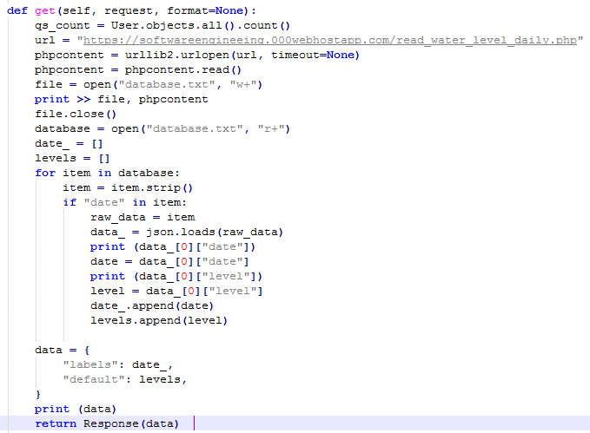
Important Python Code
views.py (extract data from php file)
Package needed: Code:
import json
import urllib2

Slide 4
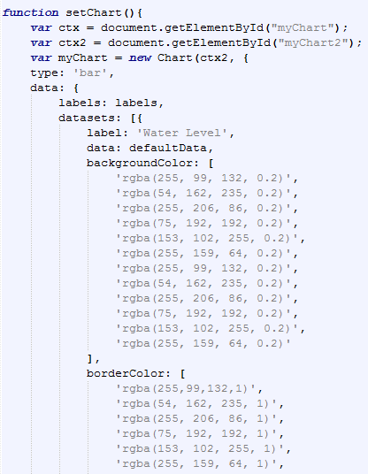
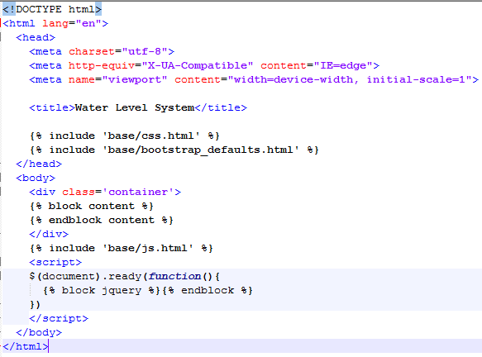
html file for graph specification
chart.html: base.html:

Slide 5
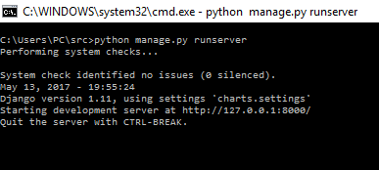
Steps to produce web page
Run the manage.py:
Goto: http://127.0.0.1:8000

Slide 6
Android

Slide 7
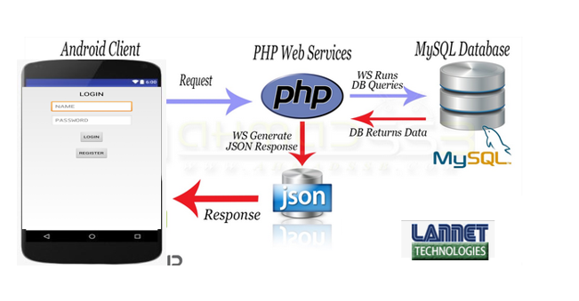
Android app flow ( request & response)
Android apps using android studio software
Java
Login.java
Register.java
Home.java
Xml ( layout)
Login.xml
Register.xml
Home.xml
Php
Init.php
To setup connection to database
Login.php
To send user information and retrieve from database for compare purposes
Register.php
To send and store user information to database
Database MySQL
https://www.000webhost.com
Table
User_info
For login and register
Water_level_detection
For data retrieve

Slide 8
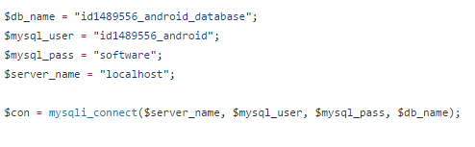

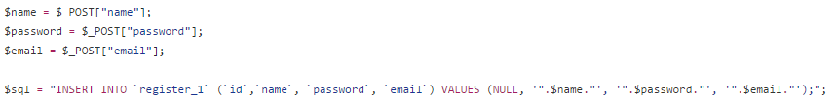
Php file
Init.php
Login.php
Register.php

Slide 9
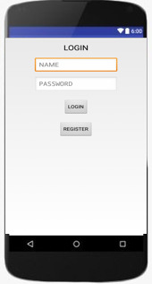
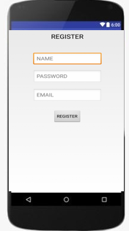
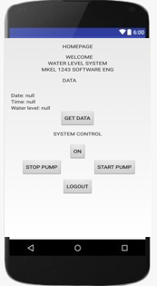
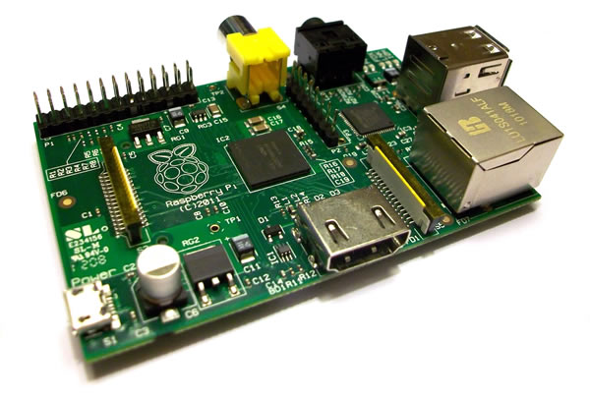
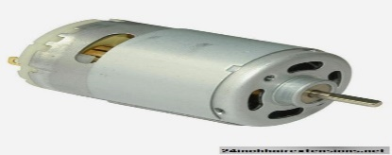
Android app user interface
System Control
ON
START PUMP
STOP PUMP

Slide 10
Rasberry pi

Slide 11





Raspberry Pi GPIO
All Rpi GPIO interaction is setup using Python language
water_system.py
start_pump.py
cleanup.py

Slide 12

Raspberry Pi Webserver
To run Rpi remotely, webserver setup is needed
There are several choices of webserver available
This project using : Apache + PHP

Slide 13
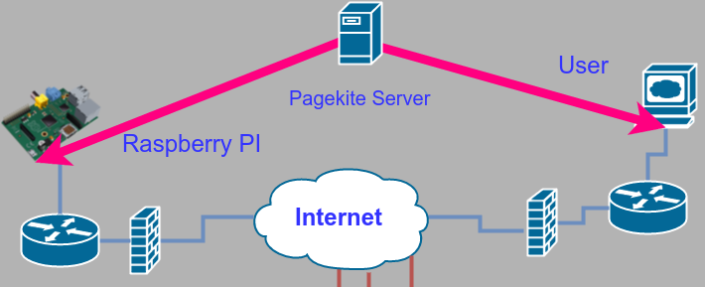
Access Raspberry Pi via Remotely
Webserver setup in Rpi can be publish to the internet for remote access
This project use PageKite as the server to create accessible domain for user

Slide 14
webserver

Slide 15
Element in Web Server

Slide 16
Data Flow

Slide 17
Backup

Slide 18
Web server
https://softwareengineeing.000webhostapp.com

Slide 19
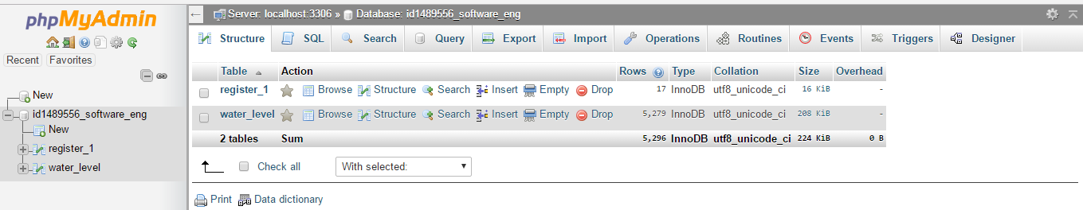
Database

Slide 20
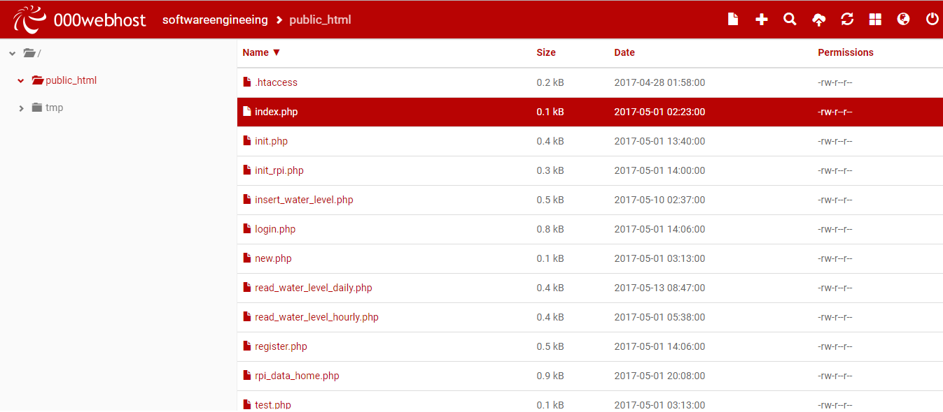
php files

